Slide 1
Model 3 Introduction to Software Security
Lesson 1: Failures, flaws, common vulnerabilities

Slide 2
Module 3: Introduction to Software Security
Module Description:
This module discusses common software vulnerabilities, malware and software secure design principles. Software vulnerabilities, such as buffer overflow, integer overflow, are introduced in the first micro module, followed by a discussion of corresponding countermeasures. Virus, worm, Trojan horse and more malware are introduced in the second micro module. The last micro module focuses on software secure design principles and secure coding.
Topics:
Lesson 1: Failures, flaws, common vulnerabilities
Lesson 2: Malware
Lesson 3: Software security and secure design principles

Slide 3
Lesson 1: Failures, flaws, common vulnerabilities
Topics:
Failure, flaw, error, fault, and other concepts.
Common software vulnerabilities (buffer overflow, integer overflow, off-by-one) and their countermeasures.
Learning Outcomes:
Upon completion of this lesson:
Students will be able to understand the common software vulnerabilities, such as buffer overflow, integer overflow, off-by-one error.
Students will be able to understand the countermeasures of some common vulnerabilities.

Slide 4
Warm Up:
Discussion:
Heartbleed bug is a vulnerability in the OpenSSL cryptographic software library.
What is the problem in the code?

Slide 5
Terminologies
When a human makes a mistake which is called error. The error may lead to a fault, or an incorrect step, command, process, or data definition in a computer program, design, or documentation.
A failure indicates that the system is not executing as required.
Flaw is used to describe both faults and failures.

Slide 6
Memory Layout
Three major areas:
Program code section:
Stores executable program instructions that can be executed by the processor.
Program data section:
Stores program variables that aren't local to functions, such as global and static variables.
The data section usually contains a heap which is a dynamic memory region for storing dynamically allocated variables.
Program stack section:
Stores currently executing functions, and keeps track of the chain of function calls.

Slide 7
Buffer Overflow
A buffer overflow, also known as a buffer overrun, is defined in the NIST Glossary of Key Information Security Terms as follows:
“A condition at an interface under which more input can be placed into a buffer or data holding area than the capacity allocated, overwriting other information. Attackers exploit such a condition to crash a system or to insert specially crafted code that allows them to gain control of the system.”

Slide 8
Buffer Overflow Basics
Programming error when a process attempts to store data beyond the limits of a fixed-sized buffer
Overwrites adjacent memory locations
Locations holding other program variables, or program control flow data.
Buffer could be located on the stack, in the heap, or in the data section of the process.

Slide 9
Buffer Overflow attack
To exploit a buffer overflow an attacker needs:
To identify a buffer overflow vulnerability in some program that can be triggered using externally sourced data under the attacker’s control
To understand how that buffer is stored in memory and determine potential for corrupting adjacent memory locations and potentially altering the flow of execution of the program.
Identifying vulnerable programs can be done by:
Inspection of program source
Tracing the execution of programs as they process oversized input
Using tools such as fuzzing to automatically identify potentially vulnerable programs

Slide 10
Stack Buffer Overflows
Occur when buffer is located on stack
Are still being widely exploited
Stack frame
When one function calls another it needs somewhere to save the return address
Also needs locations to save the parameters to be passed in to the called function and to possibly save register values
The data group of parameters, return address, and stack pointer is called a stack frame.

Slide 11
Overwrite stack memory
Overwrite the program counter stored in the stack.
When this routine exits, control transfers to the address pointed at by the modified program counter address.
Overwrite part of the code in low memory, substituting new instructions.
Overwrite the program counter and data in the stack so that the program counter points to the stack, causing the data overwritten into the stack to be executed.

Slide 12
Overflow Countermeasures
Staying within bounds
Programmers:
Check lengths before writing
Confirm that array subscripts are within limits
Double-check the boundary condition code
Limit input to the number of acceptable characters
Code analyzers (such as static code analyzer) can analyze source code to identify many overflow vulnerabilities.
Canary values in stack to signal modification. It is usually placed below the program counter. If the canary is overwritten, then the program counter may be overwritten.
Stackshield and Return Address Defender (RAD)

Slide 13
Heap Overflow
Attack buffer located in heap
Typically located above program code
Memory is requested by programs to use in dynamic data structures
There is no return address, so the transfer of control is not easy.
Countermeasure:
Making the heap non-executable
Randomizing the memory allocation on the heap

Slide 14
Integer Representation
Signed-magnitude
One’s complement
Two’s complement

Slide 15
Sign and magnitude
The sign of the number is stored in the sign bit.
0 for positive
1 for negative
Remaining bits (value bits) indicate the magnitude of the value

Slide 16
One’s Complement
The sign bit is 1 if the number is negative and 0 if the number is positive.
Positive values can be read directly from the value bits.
Negative values can't be read directly; the whole number must be negated first.
In ones complement, a number is negated by inverting all its bits.
0000 0000 (positive 0)
1111 1111 (negative 0)
-2
each 1 is replaced with a 0, each 0 is replaced with a 1
1 1 1 1 1 1 0 1
even the sign bit is reversed
0 0 0 0 0 0 1 0

Slide 17
Two’s Complement
The sign bit is 1 if the number is negative and 0 if the number is positive.
You can read positive values directly from the value bits.
The two’s complement form of a negative integer is created by adding one to the one’s complement representation.
For negative values, you have to negate the whole number first and then add one.
Two’s complement representation has a single (positive) value for zero.
-2
1 1 1 1 1 1 1 0
0 0 0 0 0 0 0 1
+ 1 =
0 0 0 0 0 0 1 0

Slide 18
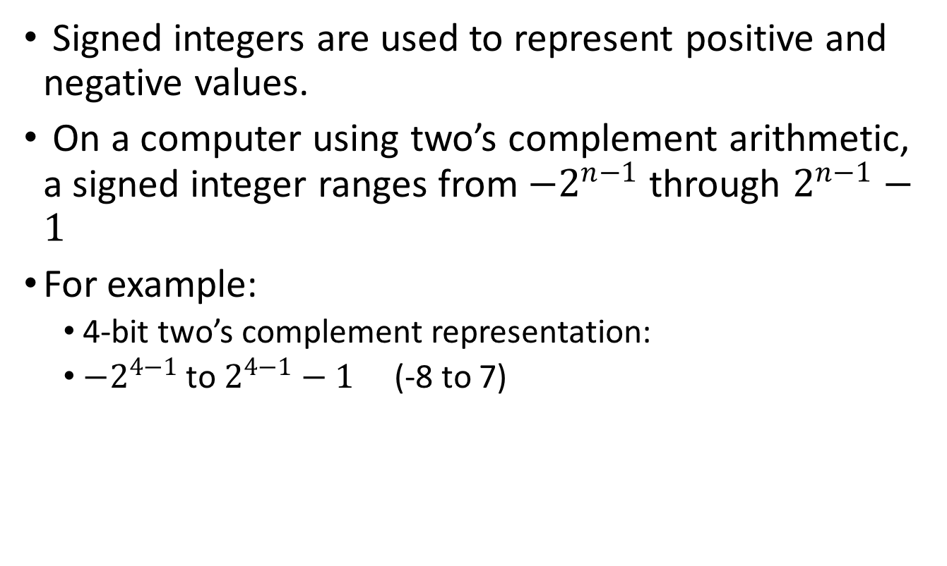
Signed Integers
Signed integers are used to represent positive and negative values.
On a computer using two’s complement arithmetic, a signed integer ranges from ${−2}^{n−1}$through $2^{n−1}−1$
For example:
4-bit two’s complement representation:
${−2}^{4−1}$to $2^{4−1}−1$ (-8 to 7)

Slide 19
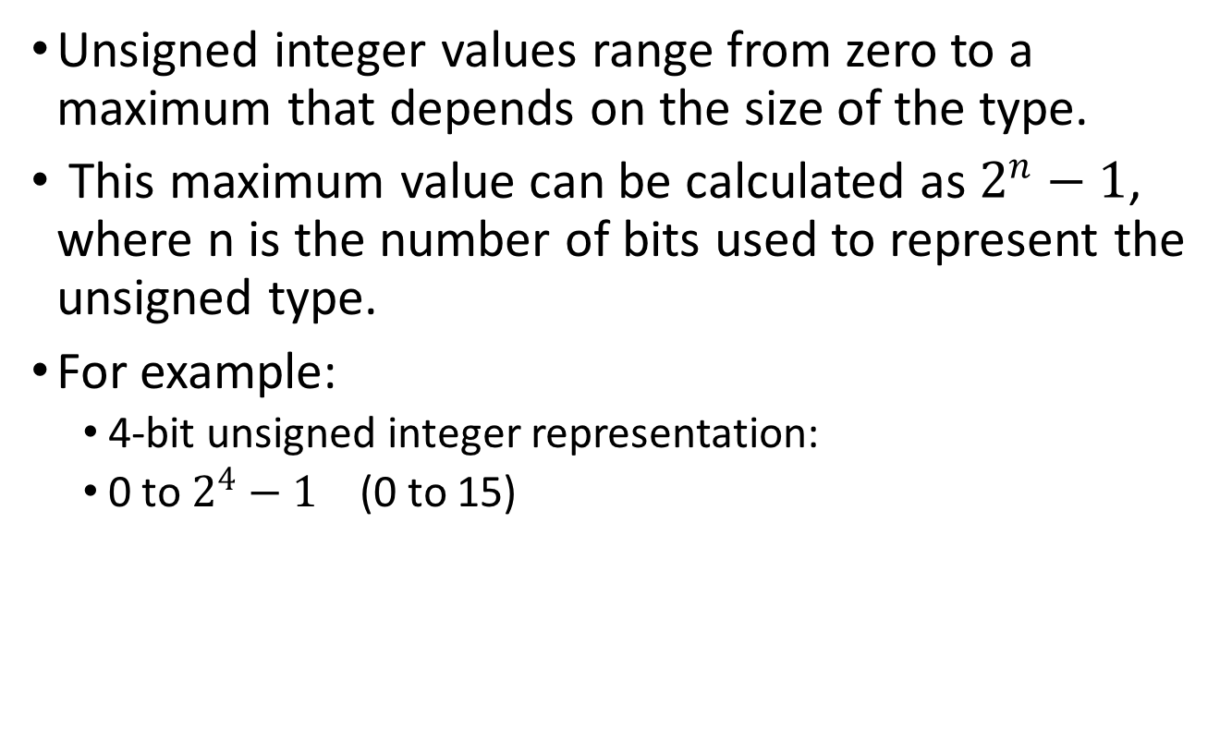
Unsigned Integers
Unsigned integer values range from zero to a maximum that depends on the size of the type.
This maximum value can be calculated as $2^{n}−1$, where n is the number of bits used to represent the unsigned type.
For example:
4-bit unsigned integer representation:
0 to $2^{4}−1$ (0 to 15)

Slide 20
Two’s Complement (Max and Min)
For example:
8-bit unsigned integer:
Max: 1111 1111 = 255
Min: 0000 0000 = 0
8-bit signed integer:
Max: 0111 1111 = 127
Min: 1000 0000 = -128

Slide 21
Maximum and Minimum Values for Integers
 | 8-bit | 16-bit | 32-bit | 64-bit
Minimum value (signed) | -128 | -32768 | -2147483648 | -9223372036854775808
Maximum value (signed) | 127 | 32767 | 2147483647 | 9223372036854775807
Minimum value (unsigned) | 0 | 0 | 0 | 0
Maximum value (unsigned) | 255 | 65535 | 4294967295 | 18446744073709551615

Slide 22
Integer Overflow
An integer overflow occurs because a storage location is fixed, finite size, so it can contain only integers up to a certain value.
An integer overflow occurs when an integer is increased beyond its maximum representable value or decreased beyond its minimum value.
Overflows can be signed or unsigned.
A signed overflow occurs when a value is carried over to the sign bit.
An unsigned overflow occurs when the underlying representation can no longer represent a value.

Slide 23
Integer Overflow example
1. int i;
2. unsigned int j;
3. i = INT_MAX; // 2,147,483,647
4. i++;
5. printf("i = %d\n", i);
6. j = UINT_MAX; // 4,294,967,295;
7. j++;
8. printf("j = %u\n", j);
i=-2,147,483,648
j = 0

Slide 24
Integer Overflow example 2
9. i = INT_MIN; // -2,147,483,648;
10. i--;
11. printf("i = %d\n", i);
12. j = 0;
13. j--;
14. printf("j = %u\n", j);
i=2,147,483,647
j = 4,294,967,295

Slide 25
Off-by-one Error
Off-by-one error: miscalculating the condition to end a loop or overlooking that an array of A[0] through A[n] contains n+1 elements.
Array indexes begin with 0 and extend to sizeof(array) - 1, so an array with 32 members has valid array indexes from 0 through 31.
Example: char A[32]; (A[0] – A[31])
common mistakes: length calculation is incorrect by one array element.
This error is typically caused by failing to account for a terminator element or misunderstanding the way array indexing works.

Slide 26
Summary
Topics:
Failure, flaw, error, fault, and other concepts.
Common software vulnerabilities (buffer overflow, integer overflow, off-by-one) and their countermeasures.

Slide 27
Please attribute Dr. Jim Alves-Foss and Dr. Jia Song, University of Idaho
Except where otherwise noted, this work is licensed under https://creativecommons.org/licenses/by-nc-sa/4.0/ Not withstanding the non-commercial license terms, non-profit educational institutions are granted a non-exclusive license to adapt and use this material, with attribution. Creative Commons and the double C in a circle are registered trademarks of Creative commons in the United States and other countries. Third party marks and brands are the property of their respective holders.
Project sponsored by the National Security Agency under grant Number H98230-17-1-0199. The United States Government is authorized to reproduce and distribute reprints notwithstanding any copyright notation herein.

